Slide 1
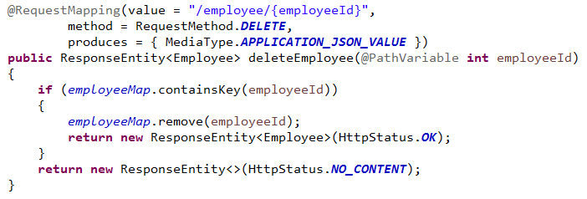
Handle HTTP Delete Request

